Slide 1
RF-Based 3D Skeletons
Mingmin Zhao, MIT
ACM SIGCOMM, 2018
Liang Xu
2019.06.04

Slide 2
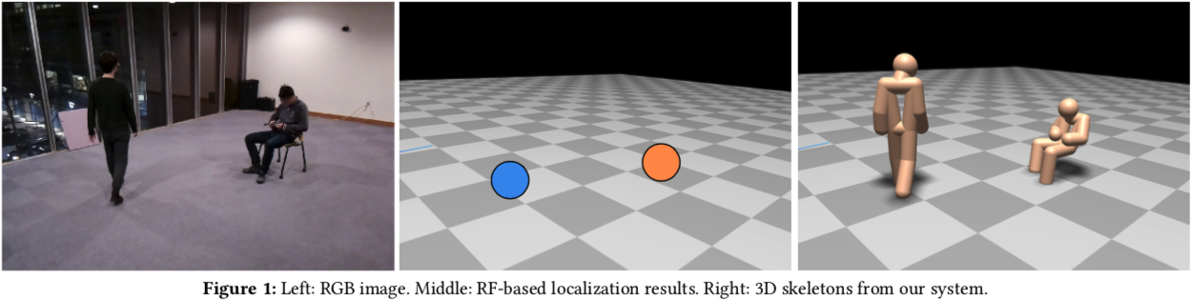
Leverage CNN to infer the person’s 3D skeleton
How to design the network?
How to get training data?
How to expand to multi-person?

Slide 3
Contents
Background
How to design the network
How to get training data
How to expand to multi-person
Results, Evaluation

Slide 4
Background
RF signals to localize people and track their motion
Without carrying wireless transmitters
detect actions like falling, walking, sitting
=> RF signals carry impressive amount of information and their movements
=> RF-Pose3D, extract full skeletons of people

Slide 5
Background
Applications in gaming, work across occlusions
Enforcement personnel to assess a hostage scenario
Healthcare, track motion disorders

Slide 6
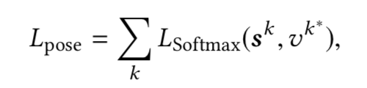
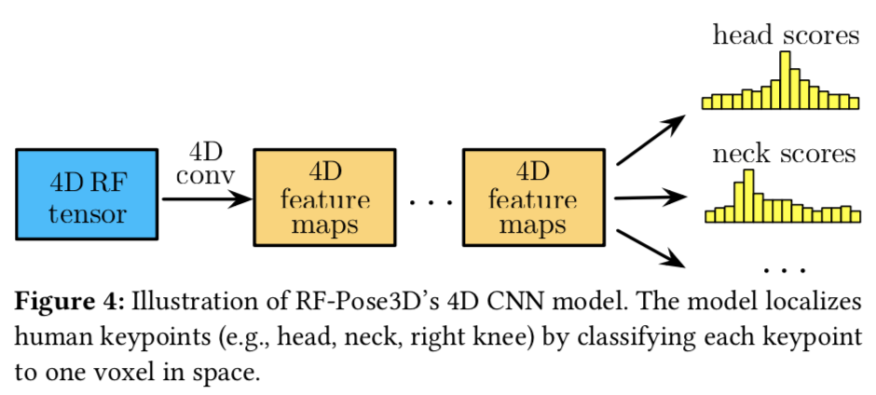
How to design the network
Keypoint localization as CNN classification
Discretize space of interest into 3D voxels
Loss Function:

Slide 7
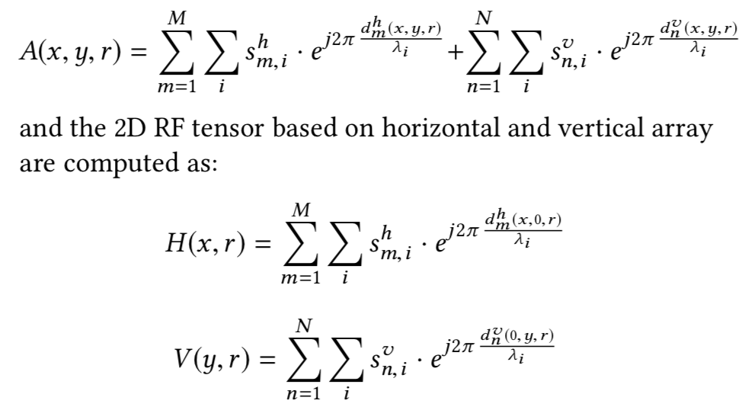
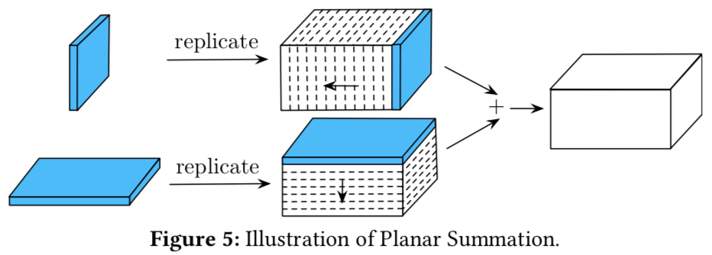
How to design the network
Input: 4D, <x y r t>
Decompose O(XYRT) to
O(XRT + YRT)

Slide 8
How to get training data
Portable and Passive
  generalizable, without wearing any markers
Accurate and Robust
  occlusions
Multi-camera system
  12 camera nodes

Slide 9
How to get training data
2D skeleton generation
  OpenPose
2D skeleton association
  hierarchical clusterings
Triangulating 3D skeletons
  calibration matrix transform

Slide 10
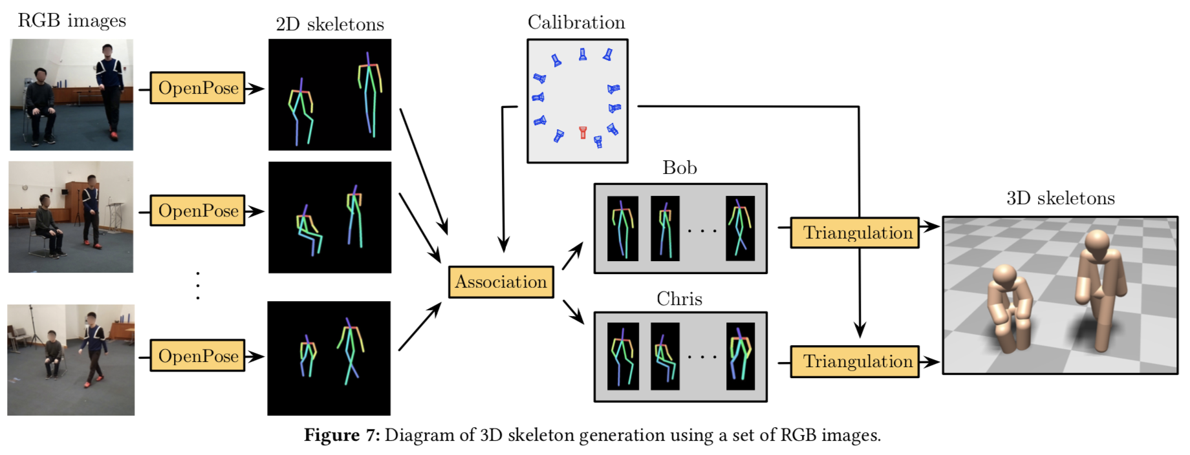
How to get training data

Slide 11
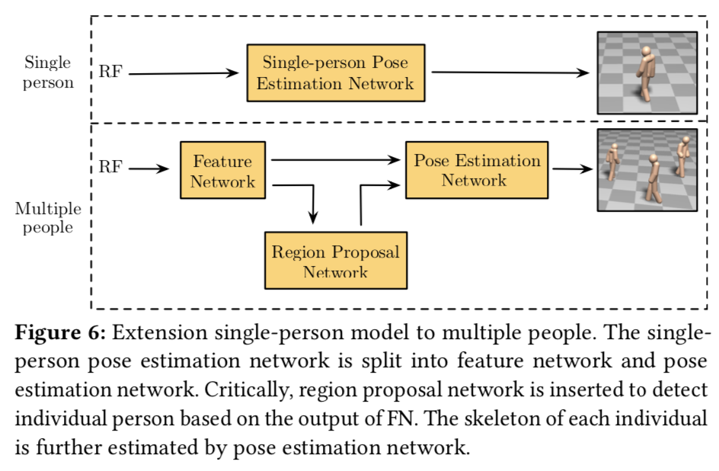
How to expand to multi-person

Slide 12
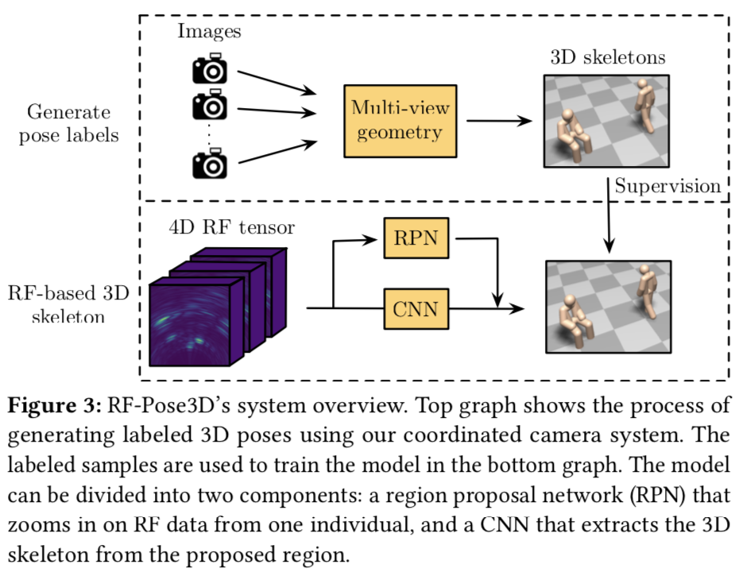
Whole Architecture

Slide 13
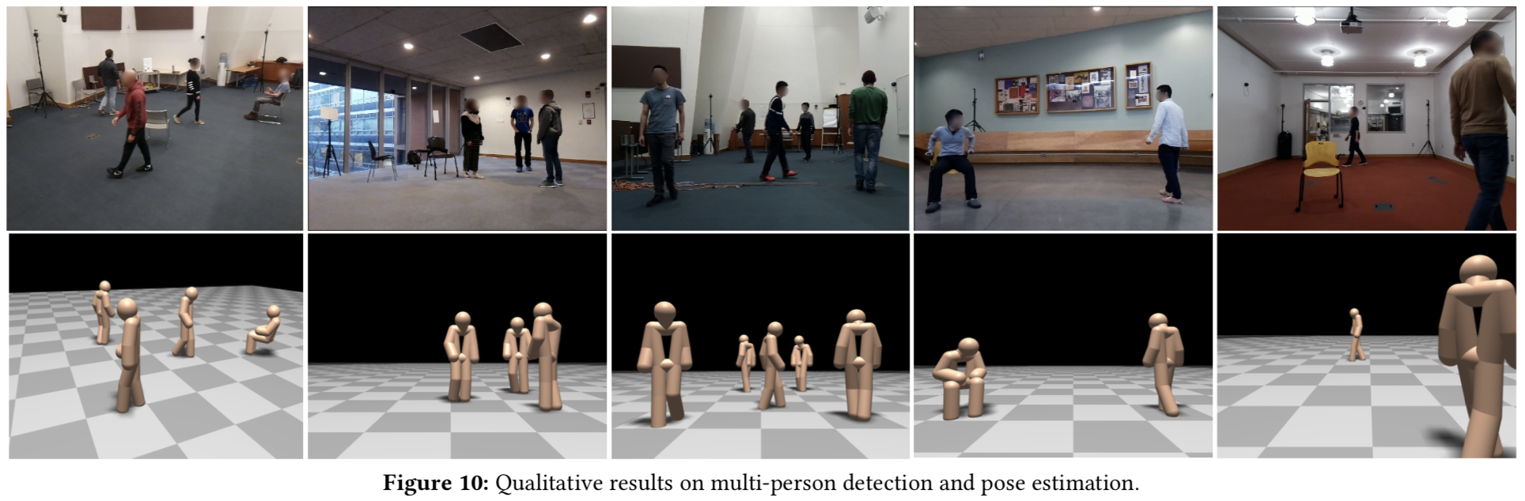
Results

Slide 14
Thank you

